Slide 1

Machine Learning for Cyber Security
Mesut GUVEN, Ph.D.

Slide 2
information
Exams; 55% (Mid 25% + Final 30%), Homeworks; 15%, Project; 30%
In homeworks, you will be expected to examine SCI/E papers (published in last 3 years).
In Final Project, you will implement an AI/ML-based cyber solution.
Textbook:
- Getting Started with Deep Learning: Programming and Methodologies using Python
- Hands-On Machine Learning with Scikit-Learn, Keras, and TensorFlow, 2nd Edition
Code: GitHub
Videos: YouTube

Slide 3
UNIT 1: INTRODUCTION
Learning Outcomes;
- To have a better understanding of Machine Learning approaches,
- To have a better understanding of Features, Datasets and Preprocessing of data,

Slide 4
TOOLS
Python is the most popular programing in ML and Data Science, and to build our models, we will use the Python. A prime will be provided https://colab.research.google.com/drive/1GpeTlzbZero7mNg6NE23yA-pawsJL-cG?usp=sharing
Numpy, Pandas, Skit-learn, etc. Necessary libraries,
TensorFlow (Google’s toolkit for ML), Keras API, etc.
Google’s Colab will be used as our development environment. It is an interactive notebook (like Jupyter Notebook) hosted by Google cloud.
GPUs, CPUs, TPUs (Unlike Colab, you should download and install Python, and all necessary packages).

Slide 5
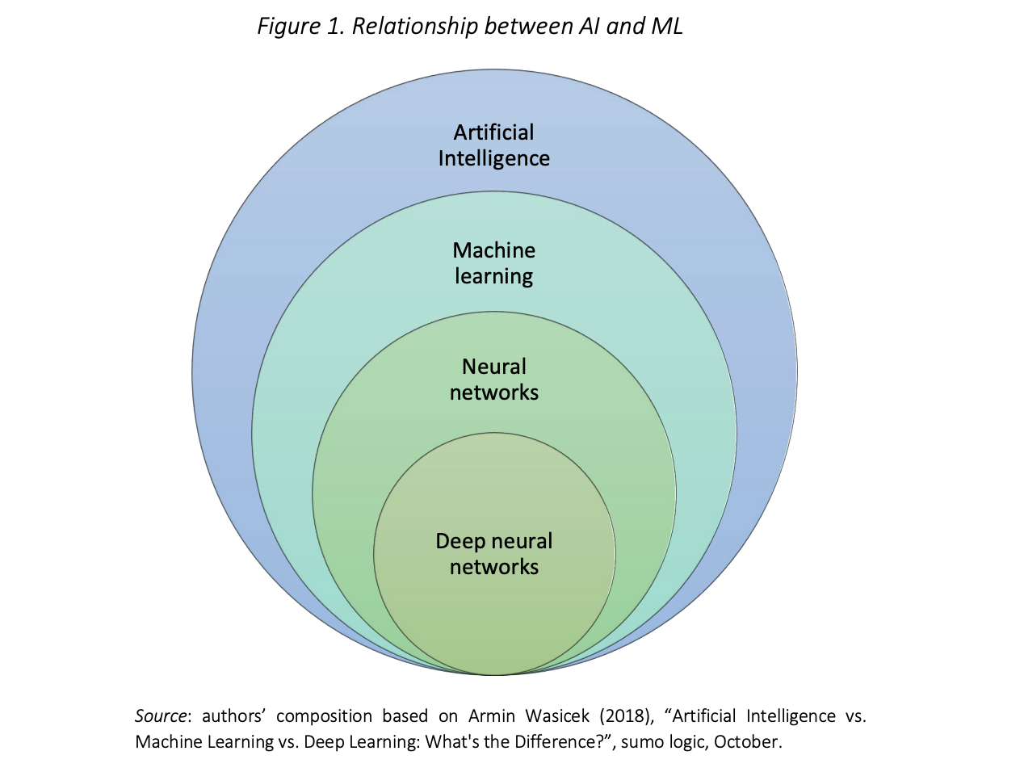
Terms
ML applications are now being used in literally every industry.
For example, in health, DL can now detect skin cancers and other ML algorithms such as ensemble models can detect heart diseases as accurate as trained cardiologists.
Another example is autonomous vehicles and games (Google Deep Mind beat the best Go player).

Slide 6
Terms
Artificial Intelligence (AI) : The field of science to make computers (machines) achieve human-style intelligence. AI consists the terms Machine Learning and Deep Learning.
Machine Learning (ML) : Techniques in which computers are trained to extract information from data based on a model. Models can either be used for prediction or regression tasks.
Neural Networks (NN): A construct in ML inspired by the nerve cells in biological brain. NN consists of fully connected nodes of three layers, respectively; input layer, one hidden-layer, and output layer.
Deep Learning (DL) : A subfield of machine learning that uses multi-layered neural networks.

Slide 7
Terms
Supervised Learning and Unsupervised Learning : In supervised learning, you have the ground truth data and a labeled data. On the other hand, in unsupervised learning, you do not have the labels. So, to extract information first we need to discover the data distribution. This is often accomplished by grouping or clustering the data. Supervised learning is the most common type of machine learning and will be the focus of this course.
Cyber Security (CS): To oversimplify; Cybersecurity is the application of technologies, processes and controls to protect systems, networks, programs, devices and data from cyber attacks. Common cyber treats include;
- Malware (ransomware, botnet software, viruses, worms, etc.),
- Backdoors, which allow remote access,
- DDoS (distributed denial-of-service) attacks, which flood servers, systems and networks with traffic to knock them offline,
- DNS (domain name system) poisoning attacks, which compromise the DNS to redirect traffic to malicios sites.

Slide 8
ML BASICS
ML Algorithms (most commmon ones);
- Naïve Bayes,
- Decision Trees, Random Forests,
- KNN,
- Linear Regression,
- Logistic Regression,
- Neural Networks, Deep Neural Networks (DL),
- Support Vector Machines,

Slide 9
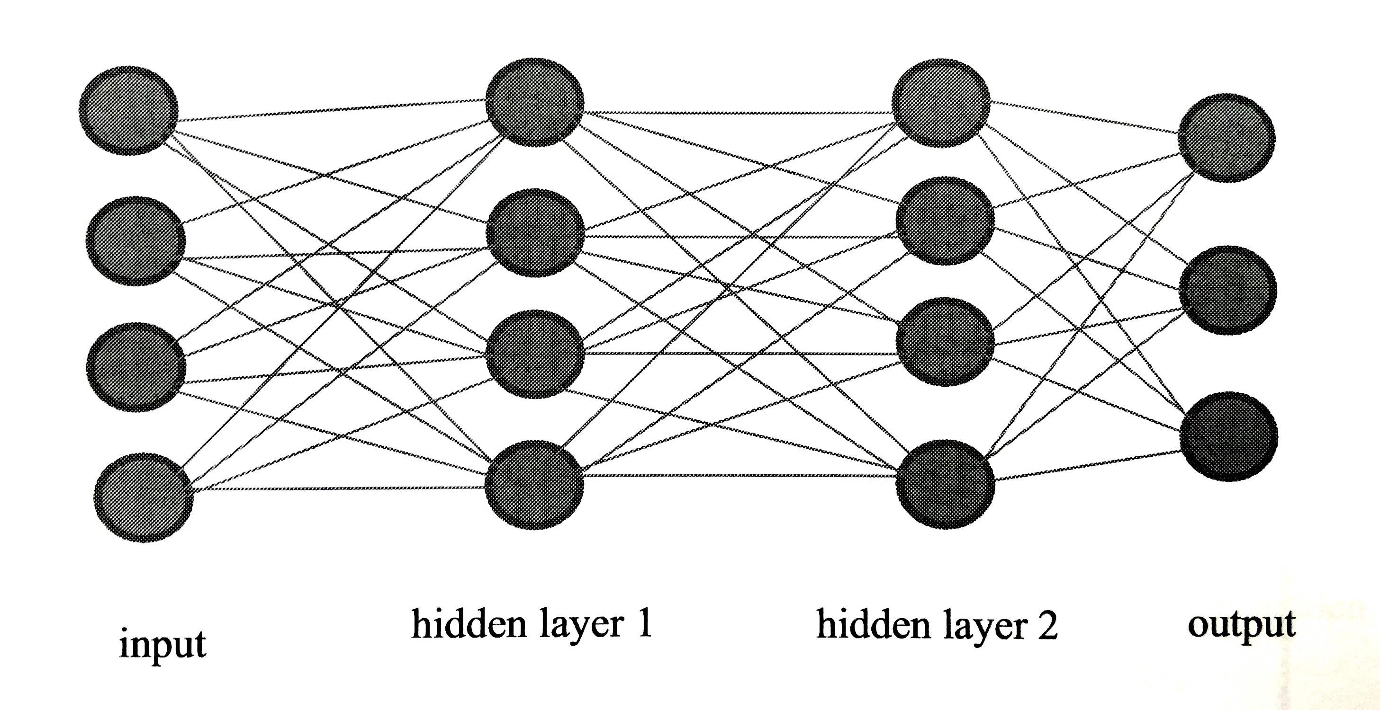
ML BASICS
Deep Neural Networks/Deep Learning:
HOW DEEP IS IT ?
There is no consensus about how many hidden layers should NN have to be classified as a DL. But NN which have more than two hidden layers are considered as Deep Neural Networks.
Activation Functions (Linear Unit/ELU, RELU, Sigmoid, etc.) enabled NN to solve non-linear problems.
Batch processing for big data.
Matrix multiplication operation takes advantage of GPUs
DL algorithms have outperformed all others since around 2012.

Slide 10
ML BASICS
ML Terms;
- Features,
- Data sets,
- Pre-processing,
- Model construction and performance evaluation

Slide 11
ML BASICS
Data Formats
- .csv files; 0,tcp,http,SF,162,4528,0,0,0,1, … ,normal.
- .libsvm; [label] [index 1]:[value 1] [index 2]:[value 2] …
- images; rgb values of range [0-255] 32x32x3, 128x128x3, etc.
Data Sets
- Malware, Ransomware, Denial of service, Honeypot unsupervised, NSL-KDD network intrusion, Phishing, Unsw big data networking,
- MNIST, Iris, Cats vs Dogs, etc. (for image processing implementations of DL)

Slide 12
ML Pipeline
Data
Pre-processing (formatting, tokenization, etc.)
Vector Space Model
ML Algorithm/Model

Slide 13



Companies using ml
Tesla
Facebook
Google
Amazon (Alexa for instance)
Apple 
Microsoft

Slide 14


Companies using ml for cyber
Northrop Grumman
BluVector
Banks
Etc.

